Slide 1
COMPARATIVE ANALYSIS OF BRITANNIA & SUNFEAST BISCUITS IN ORGANIZED RETAIL
Yash Vijaykumar Mohite
V61

Slide 2

Industry Overview
The largest food industry in India is the biscuit industry, which has an annual revenue of over Rs. 3000 crores. India is regarded as the world's second largest biscuit producer, after the United States. There are two categories for it: organized and disorganized. Around 80% of all bakery items sold in India are made up of bread and biscuits, which dominate the sector. Bread is produced and valued at a lower level than biscuits. This makes up more than 70% of the unorganized sector of the baking industry.
In the latter half of the 20th century, as demand for ready-made food goods at reasonable prices increased in the urbanized society, the India Biscuits Business came to the forefront and began developing a solid reputation in the baking industry.

Slide 3




Major players in the market
Parle products Pvt. Ltd
ITC Ltd
Anmol Industries Ltd
Priya Gold: Surya food Pvt Ltd

Slide 4

About the company
One of India's top food firms, Britannia Industries has a 100-year history and generates more than Rs. 9000 Cr in annual revenue. Britannia is one of the most reputable food companies, producing well-known products in India as Good Day, Tiger, NutriChoice, Milk Bikis, and Marie Gold. The product line offered by Britannia consists of biscuits, bread, cakes, rusk, and dairy items like cheese, beverages, milk, and yoghurt. Many generations of Indians have grown up with the Britannia brand, and our brands are cherished and adored in India and around the world. Over 50% of Indian homes are served by the near to 5 million retail locations where Britannia products are sold throughout the nation.

Slide 5
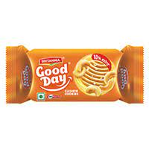
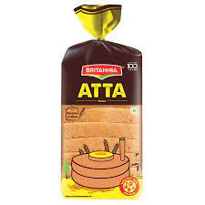
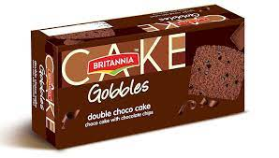
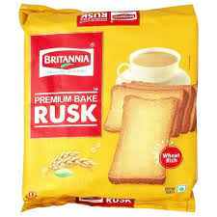
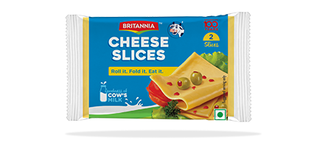

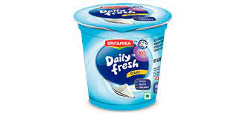
Products
Biscuits
Bread
Cake
Rusk
Cheese
Yoghurt
Milk

Slide 6
On the job training
Key results area of the organization
Customer Satisfaction
To handle quarries
Approach the customer
Convincing

Slide 7
Work Responsibilities Assigned
Selling of biscuits
Pop (Point of Purchase) Handling
Checking the offers of product
Stock Management of Britannia
Study about the product
Building Relationship with customer

Slide 8
Project Execution Methodology
Visiting the store
Check the stocks of biscuits
Report to the Departmental Manager
Check the offers of the buscuits
Make PoP of the biscuits
Interact with the customers
Pitching customers
Check for the stock
Report to the Departmental Manager
Leave the store

Slide 9
Findings & Learnings
Britannia | Sunfeast | Britannia | Sunfeast
Bourbon | Bourbon | 927 | 320
Goodday 200gms | Momsmagic 200gms | 468 | 59
Goodday 600gms | Momsmagic 600gms | 677 | 72
Marigold 1kg | Marielight 1kg | 389 | 214
From the graph we can predict that the Britannia product sales is higher than the Sunfeast products. As we all know that Britannia is the leading biscuits player in India with the market capitalization over 28% in the market.

Slide 10
Suggestion
Britannia can improve the quality of packaging of their products which can attract more customer attraction and can increase their sales of the product.
Instead of using Film stars in the advertisement they can use small actors which can perform better & Britannia is a big brand which doesn’t need much advertisement they need to just spared awareness of the products.
They should expand their business overseas to capture the market of biscuits and they can gain more revenue.
Britannia can start giving offers like Buy 1 Get 1 free, buy 2 Get 1 free and many more from this we can attract more customers.
They can more focus on Cake segment to gain more revenue.

Slide 11


